Slide 1
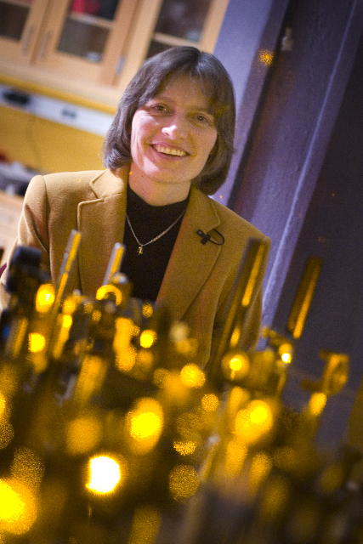
Lene Hau
Notes:
# Name Lene Hau # Textbook Knight, Physics for Scientists and Engineers: A Strategic Approach with Modern Physics, 3rd Edition, Chapter 40 # Textbook Knight, College Physics: A Strategic Approach, 2nd Edition, Chapter 40 # Contributors # Description Lene Vestergaard Hau (born November 13, 1959 in Vejle, Denmark) is a Danish physicist. In 1999, she led a Harvard University team who, by use of a Bose-Einstein condensate, succeeded in slowing a beam of light to about 17 metres per second, and, in 2001, was able to stop a beam completely. Later work based on these experiments led to the transfer of light to matter, then from matter back into light,[2] a process with important implications for quantum encryption and quantum computing. More recent work has involved research into novel interactions between ultracold atom and nanoscopic scale systems. In addition to teaching physics and applied physics, she has taught Energy Science at Harvard,[3] involving photovoltaic cells, nuclear power, batteries, and photosynthesis # Sources https://en.wikipedia.org/wiki/Lene_Hau # Photo https://upload.wikimedia.org/wikipedia/commons/5/5e/Professor_Lene_Hau_in_her_laboratory_at_Harvard.jpg

Slide 2
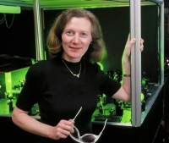
Margaret Murnane
Notes:
# Name Margaret Murnane # Textbook Knight, Physics for Scientists and Engineers: A Strategic Approach with Modern Physics, 3rd Edition, Chapter 32, section 2 Halliday Resnick and Walker, 6th edition, Chapter 6 # Description Margaret Murnane is an optical physicist at the University of Colorado. She has built "the fastest things that humans have ever created" lasers which can flash for "ten quadrillionths of a second"! Her background includes the fact that "physics was [her] worst subject in high school" but she dreamed of being a physicist because she loved the "excitement of discovery." She and her husband now run a lab at the University of Colorado. In the lab, she records "some of the fastest motions in our natural world." Her lasers can capture the movement of electrons. Her newest laser and x-ray beams can flash for less than 0.00000000000000001 seconds. Talk about "in the blink of an eye!" She is able to pass on excitement and knowledge to students. Scientists use her lasers which are based on her titanium-sapphire design to study a wide range of phenomena (chemical reactions, etc.). # Sources https://en.wikipedia.org/wiki/Margaret_Murnane https://jila.colorado.edu/kmlabs/bio/murnane # Photo https://jila.colorado.edu/kmlabs/sites/default/files/styles/200_image/public/images/bios/Margaret_Murnane_portrait.jpg?itok=jY-_AF2Q https://www.colorado.edu/physics/sites/default/files/styles/small/public/people/murnane_margaret_final.jpg?itok=5D4kIR1j

Slide 3
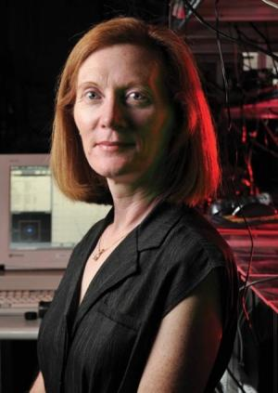
Margaret Murnane
Notes:
# Name Margaret Murnane # Textbook Knight, Physics for Scientists and Engineers: A Strategic Approach with Modern Physics, 3rd Edition, Chapter 32, section 2 Halliday Resnick and Walker, 6th edition, Chapter 6 # Description Margaret Murnane is an optical physicist at the University of Colorado. She has built "the fastest things that humans have ever created" lasers which can flash for "ten quadrillionths of a second"! Her background includes the fact that "physics was [her] worst subject in high school" but she dreamed of being a physicist because she loved the "excitement of discovery." She and her husband now run a lab at the University of Colorado. In the lab, she records "some of the fastest motions in our natural world." Her lasers can capture the movement of electrons. Her newest laser and x-ray beams can flash for less than 0.00000000000000001 seconds. Talk about "in the blink of an eye!" She is able to pass on excitement and knowledge to students. Scientists use her lasers which are based on her titanium-sapphire design to study a wide range of phenomena (chemical reactions, etc.). # Sources https://en.wikipedia.org/wiki/Margaret_Murnane https://jila.colorado.edu/kmlabs/bio/murnane # Photo https://jila.colorado.edu/kmlabs/sites/default/files/styles/200_image/public/images/bios/Margaret_Murnane_portrait.jpg?itok=jY-_AF2Q https://www.colorado.edu/physics/sites/default/files/styles/small/public/people/murnane_margaret_final.jpg?itok=5D4kIR1j

Slide 4
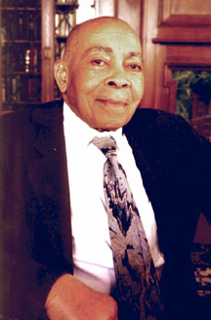
Warren Henry
Notes:
#Name Warren Henry # Textbook Knight, Physics for Scientists and Engineers: A Strategic Approach with Modern Physics, 3rd Edition, Chapter 30, section 4 #Contributors Joshua Maclin # Description Warren Henry was an African American Physicist that had somewhat of an astute background for a black man of his time. Both of his parents had graduated from the Tuskegee Institute, and George Washington Carver lived and conducted research on his parent’s farm during the summer months (Williams). It can be quite apparent to see where his interest in the sciences more than likely came from during his childhood. He later attended Tuskegee where he majored in Mathematics, English, and French (Williams). Later wanting to conduct research, he turned to Rutgers University where they then turned him away (Williams). As a result, he ended up going to the Naval Research Laboratory where he would reside for the next 12 years (Williams). During that time he was able to research and gain the knowledge of materials that were at a rather low temperature (Williams). His expertise regarding low-temperature research was probably unsurpassed in the U.S. while at the Naval Research Laboratory. He was also the head of several projects at several institutions like UC Berkeley amongst others. Even though his research in low temperatures was quite significant, he was most known for his work in magnetism and superconductivity. His work in this field was what brought him the most praise by the scientific community. He had written a highly detailed study that consisted of a "demonstration of the proof of non-interacting paramagnetic ions and how they’re a significant contribution” when considering magnetism and superconductivity (Williams). His work was a significant contribution to the world because his models and ideas have been implemented into modern textbooks, and are still widely used to this day. A prime example of that being the demonstration I had spoken of earlier that took place back in 1934. In relation to where Henry’s work can be found in the textbook, I would imagine that his material could be found in chapter 32 and 33 where it talks about the magnetic field of a current and electromagnetic induction. # Sources Physics Central. “Africn Americans in Physics.” Physics Buzz, American Physical Society, 27 Feb. 2013, http://physicsbuzz.physicscentral.com/2013/02/african-americans-in- physics.html Williams, Scott. “Physicist of the African Diaspora - Warren E Henry.” Warren E. Henry - Physicist of the African Diaspora, Bonvibre & Daughters, http://www.math.buffalo.edu/ mad/physics/henry_warren.html # Photo http://www.math.buffalo.edu/mad/PIX/henry_warren.howard1.jpg

Slide 5
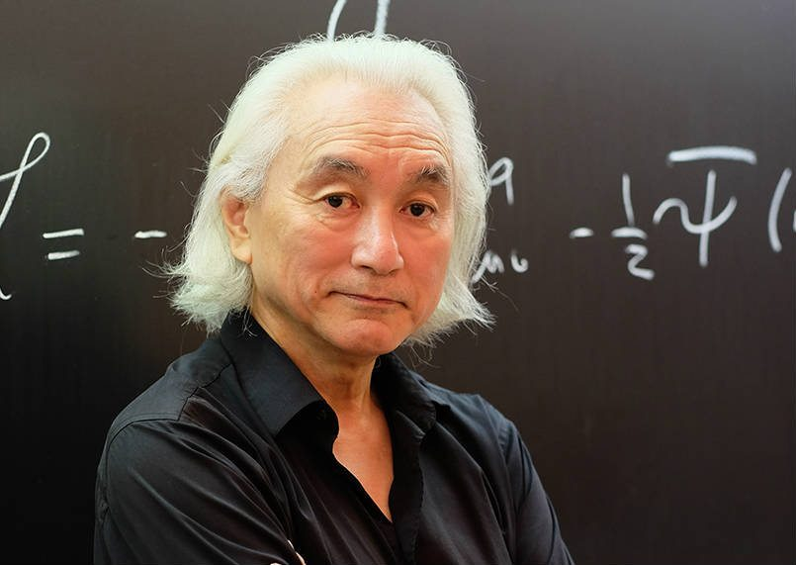
Michio Katu
Notes:
# Name Michio Katu # Textbook Knight, Physics for Scientists and Engineers: A Strategic Approach with Modern Physics, 3rd Edition, Chapter 28 # Contributors Yuyu Zhang # Description Professor Michio Kaku, born in 1947, is a theoretical physicist, futurist, and popularizer of science. He is one of the co-founder of string field theory, a branch of string theory, which intends to unite Albert Einstein's earlier findings with quantum physics. His research focuses on superstring theory, supergravity, supersymmetry, and hadronic physics. He has authored more than 70 articles and several highly-accessible science books. He grew up a science enthusiast. Story has it that he built an atom smasher in his parents' garage for his high school science fair. His effort to popularize science has made him a well-known public figure. He has made multiple appearance on TV programs and film. A fun fact about him is that in 2016, he appeared in a TV commercial for Turbo Tax. He has spent majority of his academic career teaching Theorectical Physics at the City College of New York. # Sources Michio Kaku Biolography (April 2,2014) Retrived from <https://www.biography.com/people/michio-kaku-21429817> access date February 18, 2018) # Photo https://innotechtoday.com/wp-content/uploads/2017/03/Micio-new-2.jpg

Slide 6
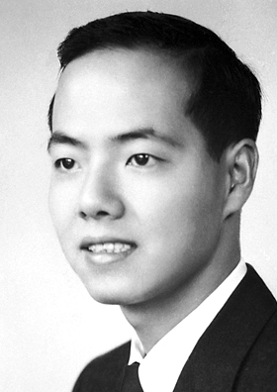
Tsung-Dao Lee
Notes:
# Name Tsung-Dao Lee # Textbook Knight, Physics for Scientists and Engineers: A Strategic Approach with Modern Physics, 3rd Edition, Chapter 42, Section 2 # Textbook # Textbook # Contributors Khai Nguyen # Description Tsung-Dao Lee is a Chinese-American physicist, known for his work on parity violation, the Lee Model, particle physics, relativistic heavy ion physics, nontopological solitons and soliton stars. He was a recipient of the 1957 Nobel Prize in Physics at the age of 30. Lee conducted the majority of his life's research at Columbia University, where his first work was on a solvable model of quantum field theory known as the Lee Model. Later, he worked on the puzzle of K meson decay, through which he studied parity non-conservation in weak interactions. This work led to his winning the Nobel Prize in Physics. He was also very active in statistical mechanics, astrophysics, and a number of other disciplines. # Sources Lee, T. D., & Yang, C. N. (1956). Question of parity conservation in weak interactions. Physical Review, 104(1), 254. Lee, T. D. (1981). Particle Physics and Introduction to Field Theory, Comtemporary Concepts in Physics Vol. 1. Harwood academic publishers. Lee, T. D., & Yang, C. N. (1952). Statistical theory of equations of state and phase transitions. II. Lattice gas and Ising model. Physical Review, 87(3), 410. Yang, C. N., & Lee, T. D. (1952). Statistical theory of equations of state and phase transitions. I. Theory of condensation. Physical Review, 87(3), 404. # Photo https://upload.wikimedia.org/wikipedia/commons/5/53/TD_Lee.jpg

Slide 7
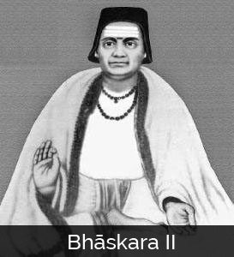
Bhāskara II
Notes:
# Name Bhāskara II # Textbook Knight, Physics for Scientists and Engineers: A Strategic Approach with Modern Physics, 3rd Edition, Chapter 17, section 4 # Contributors Jacob Harris # Description Bhāskara II was a 12th century Indian mathematician and astronomer. Among his many notable accomplishments, which include using differentials centuries before Newton “invented” calculus (Bhāskara II), Bhāskara II was one of the first to design a perpetual motion machine. The “Bhāskara wheel” has curved spokes filled with mercury, which flows downward in the direction of rotation, theoretically creating a shifting force to power perpetual rotation (Simanek 2010). Unfortunately, Bhāskara II didn’t account for the unbalancing effect of the mercury flow, which shifts the wheel’s center of mass and eventually disrupts rotation (Simanek). Bhāskara II’s design has remained a fascination for physicists and countless researchers have tried to optimize his design and create a truly perpetually rotating wheel. All have failed (Simanek). Bhāskara II was instrumental is the development of Indian mathematics, and was honored in 1981 with an eponymous satellite (Bhāskara II). # Sources “Bhāskara II.” Wikipedia: The Free Encyclopedia. Wikimedia Foundation, Inc. 22 July 2004. Web. Accessed 30 Sept. 2017. https://en.wikipedia.org/wiki/Bh%C4%81skara_II#Engineering Simanek, Donald. 2010. “The Shifting-Mass Overbalanced Wheel.” The Museum of Unworkable Devices, Lock Haven University. Accessed 30 Sept. 2017. http://www.lhup.edu/~dsimanek/museum/overbal.htm. # Photo http://www.famousmathematicians.com/wp-content/uploads/2016/09/bhaskara-273x300.jpg

Slide 8
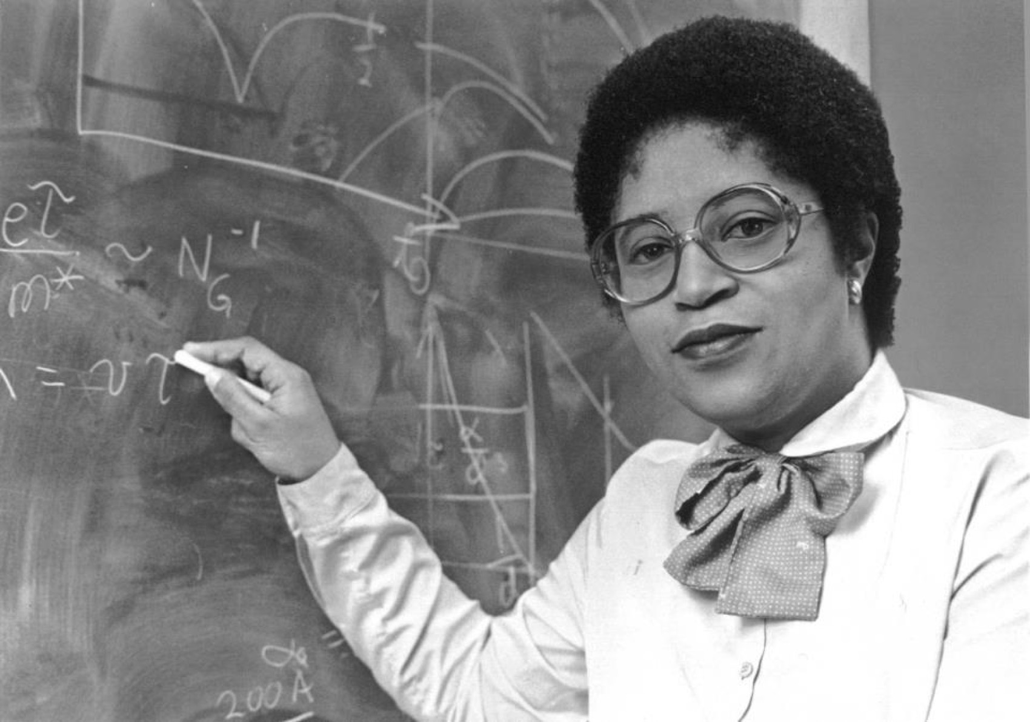
Shirley Ann Jackson
Notes:
# Name Shirley Ann Jackson # Textbook Knight, Physics for Scientists and Engineers: A Strategic Approach with Modern Physics, 3rd Edition, Chapter 22, section 1 # Textbook # Textbook # Contributors # Description Shirley Ann Jackson is an African-American physicist born in Washington D.C., on August 5th, 1946. She was the first African American women to get a PhD from MIT. Dr.Jackson studied hadrons as a research associate at the Fermi National Accelerator Laboratory in Batavia, Illinois. She was also a visiting scientist at CERN in Switzerland where she worked on theories relating to elementary particles. She was a part of the Theoretical Physics Research Department at AT&T Bell Laboratories in 1976 and studied materials used in the semiconductor industry. She also researched on the optical and electronic properties of two-dimensional and quasi-two dimensional systems. She made contributions to the knowledge of charged density waves in layered compounds and optical and electronic properties of semiconductor strained-layer superlattices. Since her postgraduate studies, she has been active in initiatives to increase African American participation in science and math. She has been serving as the president of Rensselear Polytechnic Institute since July 1, 1999. She was the first black woman to earn a PhD from MIT. She was the first black woman to be elected to the National Academy of Engineering. She did most of her research on optical and electronic properties of layered materials, surface electrons of liquid helium films, strained-layer semiconductor superlattices, and most notably, the polaronic aspects of electrons in two- dimensional systems. # Sources [https://en.wikipedia.org/wiki/Shirley_Ann_Jackson](https://en.wikipedia.org/wiki/Shirley_Ann_Jackson) [http://www.nytimes.com/ref/college/faculty/coll_pres_jacksonbio.html](http://www.nytimes.com/ref/college/faculty/coll_pres_jacksonbio.html) [Diaz, S. (n.d.). Jackson, Shirley Ann.](http://www.blackpast.org/aah/jackson-shirley-ann-1946) # Photo https://cdn-blog.adafruit.com/uploads/2015/02/Shirley-Ann-Jackson.jpg https://thenotesofe.files.wordpress.com/2015/03/jackson_8x10.jpg

Slide 9
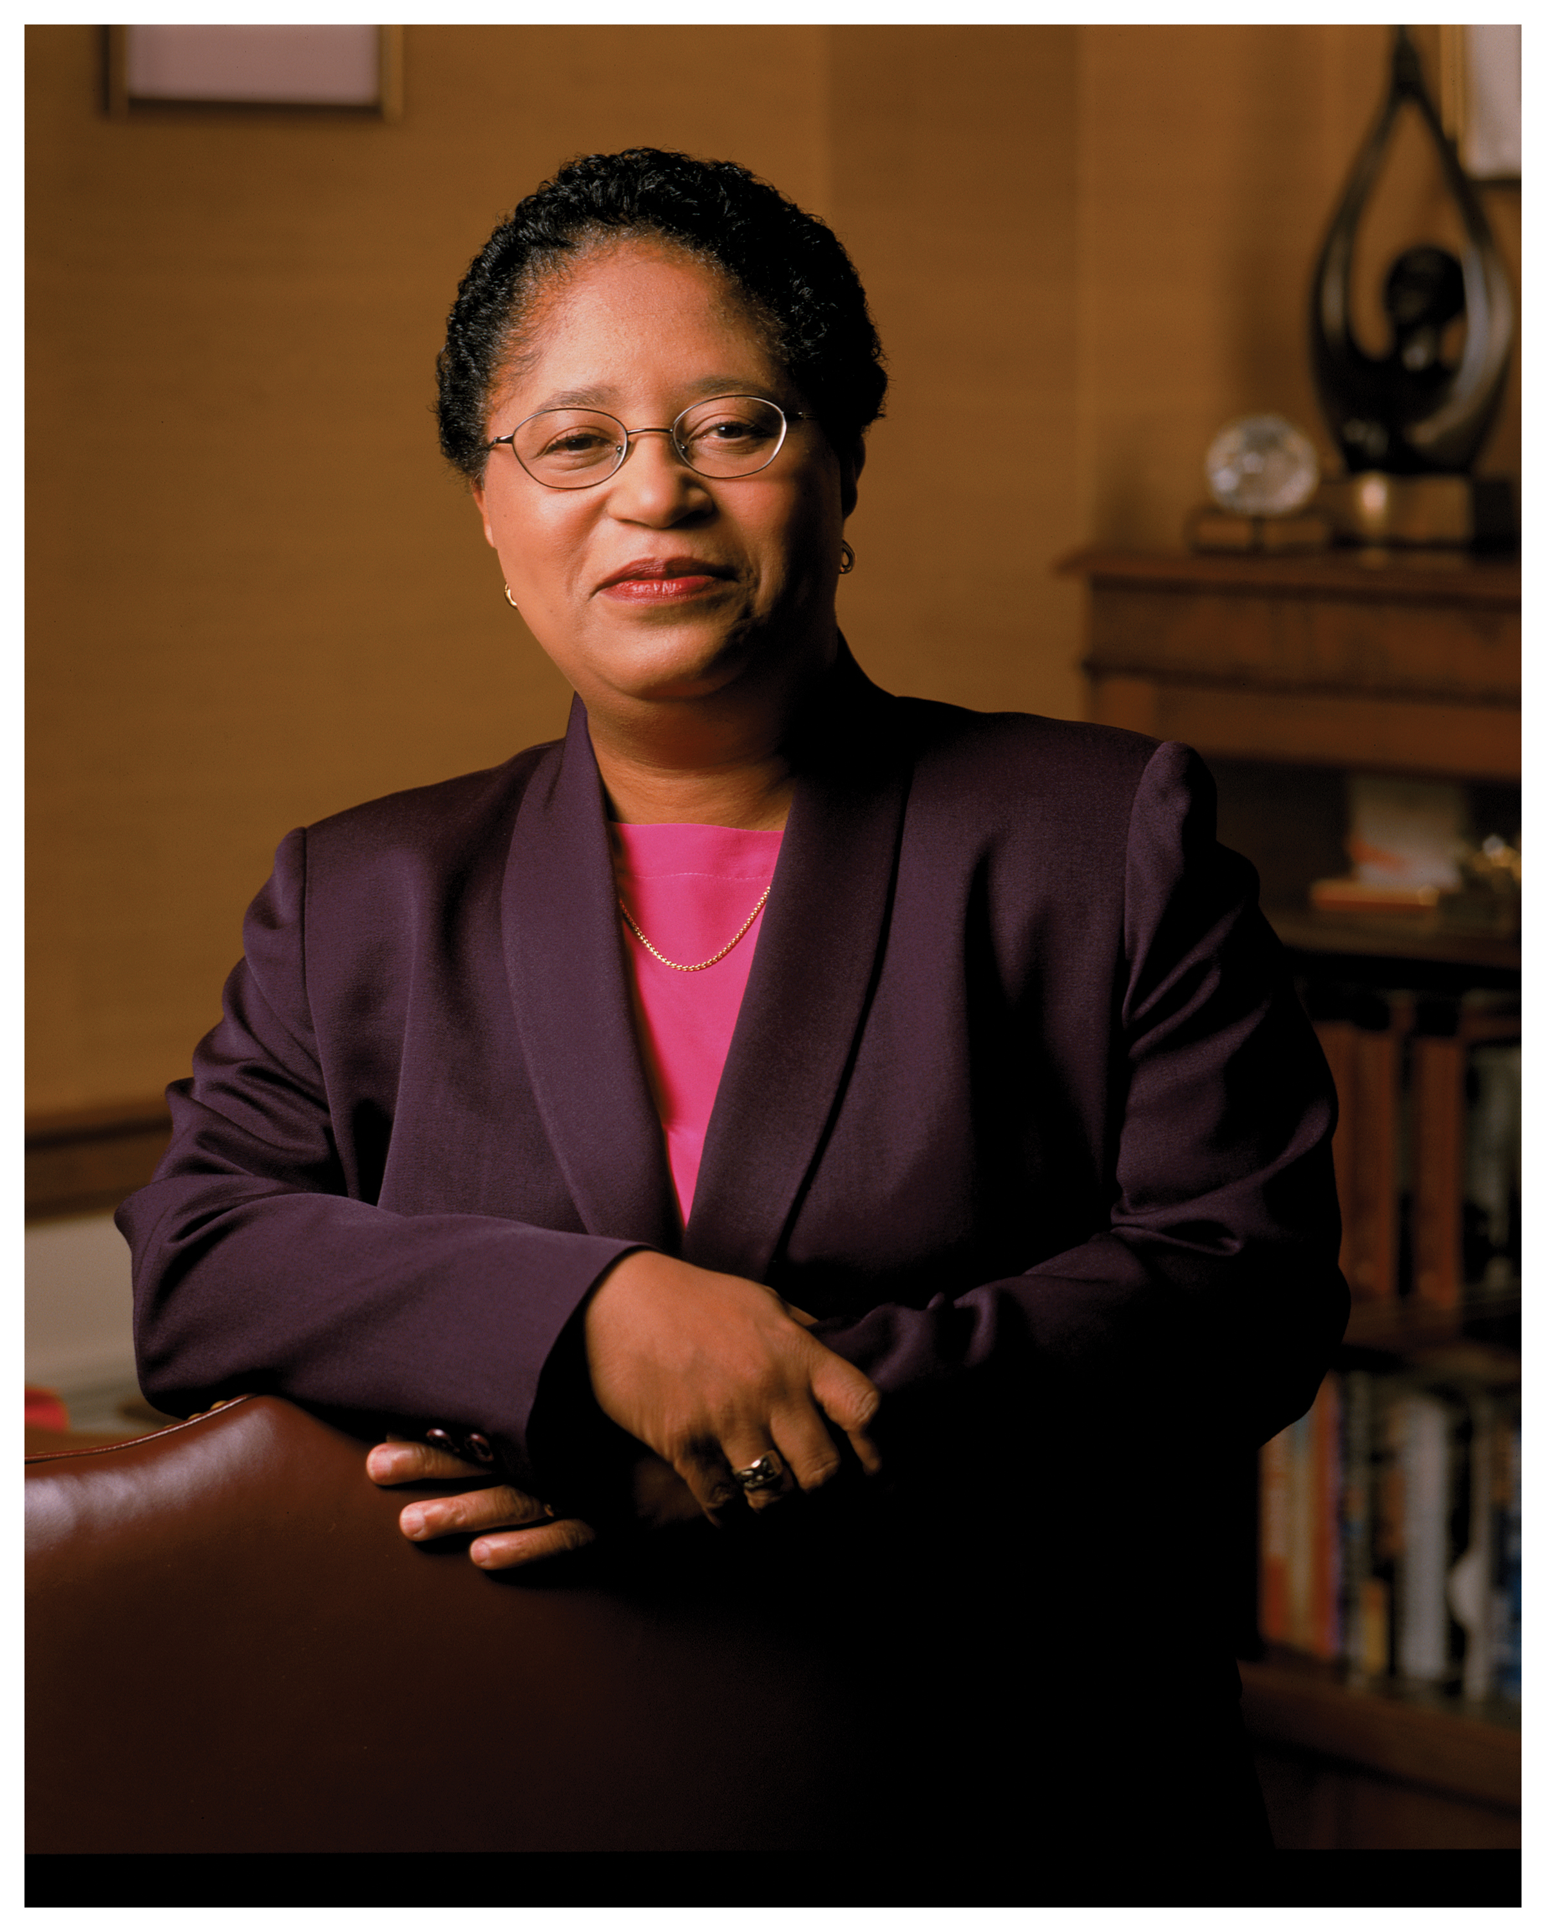
Shirley Ann Jackson
Notes:
# Name Shirley Ann Jackson # Textbook Knight, Physics for Scientists and Engineers: A Strategic Approach with Modern Physics, 3rd Edition, Chapter 22, section 1 # Textbook # Textbook # Contributors # Description Shirley Ann Jackson is an African-American physicist born in Washington D.C., on August 5th, 1946. She was the first African American women to get a PhD from MIT. Dr.Jackson studied hadrons as a research associate at the Fermi National Accelerator Laboratory in Batavia, Illinois. She was also a visiting scientist at CERN in Switzerland where she worked on theories relating to elementary particles. She was a part of the Theoretical Physics Research Department at AT&T Bell Laboratories in 1976 and studied materials used in the semiconductor industry. She also researched on the optical and electronic properties of two-dimensional and quasi-two dimensional systems. She made contributions to the knowledge of charged density waves in layered compounds and optical and electronic properties of semiconductor strained-layer superlattices. Since her postgraduate studies, she has been active in initiatives to increase African American participation in science and math. She has been serving as the president of Rensselear Polytechnic Institute since July 1, 1999. She was the first black woman to earn a PhD from MIT. She was the first black woman to be elected to the National Academy of Engineering. She did most of her research on optical and electronic properties of layered materials, surface electrons of liquid helium films, strained-layer semiconductor superlattices, and most notably, the polaronic aspects of electrons in two- dimensional systems. # Sources [https://en.wikipedia.org/wiki/Shirley_Ann_Jackson](https://en.wikipedia.org/wiki/Shirley_Ann_Jackson) [http://www.nytimes.com/ref/college/faculty/coll_pres_jacksonbio.html](http://www.nytimes.com/ref/college/faculty/coll_pres_jacksonbio.html) [Diaz, S. (n.d.). Jackson, Shirley Ann.](http://www.blackpast.org/aah/jackson-shirley-ann-1946) # Photo https://cdn-blog.adafruit.com/uploads/2015/02/Shirley-Ann-Jackson.jpg https://thenotesofe.files.wordpress.com/2015/03/jackson_8x10.jpg

Slide 10
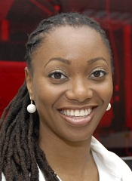
Dr. Hadiyah Green
Notes:
# Name Dr. Hadiyah Green # Textbook Knight, Physics for Scientists and Engineers: A Strategic Approach with Modern Physics, 3rd Edition, Chapter 17 # Textbook # Textbook # Contributors Irving Barrera # Description The more I learn about the scientific community, the more I learn about the issues of sexism and racism affecting women and minorities wanting to do research. There is definitely a stigma against women and women of color wanting to do research at a professional level. Countless are the cases, of female scientists that have to choose between having a family and their professional careers, and smaller is the number of women of color that have a leadership position in the labs where they do research. For this reason, it is important to shed the light on inspiring women who are making major contributions to their fields because they are role models that future scientists can look up to. I found a scientist who is making groundbreaking discoveries in the field of lasers. Her name is Hadiyah Green and she is developing laser technologies to kill cancer cells. She earned her PhD in Physics from the University of Alabama Birmingham. After her closest relatives were diagnosed with cancer, she decided to use her background to develop lasers that selectively target cancer cells through the use of nanoparticles. She has tested her treatment on mice and has obtained promising results. In the future, she hopes to advance her research to make it useful for humans. # Sources https://womenintheworld.com/2016/01/09/black-female-physicist-pioneers- technology-that-kills-cancer-cells-with-lasers/?refresh # Photo http://www.msm.edu/_resources/MSMimages/FacultyDirectoryImages/Physiology/HadiyahNGreen.jpg

Slide 11
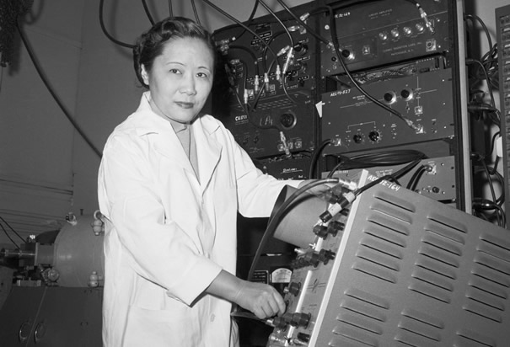
Chien-Shiung Wu
Notes:
# Name Chien-Shiung Wu # Textbook Knight, Physics for Scientists and Engineers: A Strategic Approach with Modern Physics, 3rd Edition, Chapter 42, Section 2 # Contributors Khyrul Khan # Description Chien-Shiung Wu (1912-1997) was a Chinese-American experimental physicist who made significant contributions in the field of nuclear physics1 (Wikipedia). Wu worked on the infamous Manhattan Project where she developed the process of separating uranium metal to uranium-235 and uranium-238 by gaseous diffusion1 (Wikipedia). Her work was credited to contradict the hypothetical Law of Conservation of Parity, which at the time was a well-established law and basically entailed a very complicated way of proving the idea of symmetry, where particles that are mirror images of each other will act in identical ways3 (ListVerse). Her experiments were incredibly significant in that she was able to show that one particle was more likely to eject an electron than the other and they were therefore not symmetrical and that observation overturned a 30-year belief and shattered the conservation of parity law3 (ListVerse). The discovery of parity violation was a major contribution to particle physics and the development of the Standard Model which is a paradigm of the modern quantum field theory2 (Wikipedia). It is little wonder that Wu is now hailed as “The First Lady of Physics” and the “Chinese Marie Curie”1(Wikipedia). However, unfortunately, like many of her contemporary female scientists, Wu’s work was discredited and her male co-workers Lee and Yang got awarded the Nobel Prize for Physics for ‘her’ experiment3 (ListVerse). In fact, she received no mention or credit for her significant contribution to the project until 1978, when she was awarded the inaugural Wolf Prize for Physics two decades after her ground-breaking experiment1(Wikipedia). # Sources Chien-Shiung Wu. Wikipedia. The Free Encyclopedia. Wikimedia Foundation, Inc. 20 September 2017. Web. 06 October 2017. https://en.wikipedia.org/wiki/Chien-Shiung_Wu Standard Model. Wikipedia. The Free Encyclopedia. Wikimedia Foundation, Inc. 16 September 2017. Web. 06 October 2017. https://en.wikipedia.org/wiki/Standard_Model 10 Groundbreaking Women Scientists Written Off By History. Shelby Hoebee. October 14, 2013. ListVerse. http://listverse.com/2013/10/14/10-groundbreaking-women-scientists-written-off-by-history/. Accessed 06 October 2017. # Photo http://www.history.com/images/media/slideshow/women-in-science-and-health/chien-shiung-wu.jpg

Slide 12
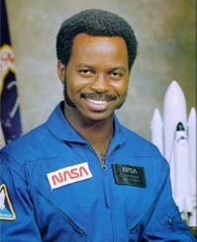
Ronald McNair
Notes:
# Name Ronald McNair # Textbook Knight, Physics for Scientists and Engineers: A Strategic Approach with Modern Physics, 3rd Edition, chapter 6, section 6 # Description McNair was an American physicist and an astronaut for NASA. He only lived until the age of 36, for he died during the launch of the Space Shuttle Challenger in 1986. He received his bachelors from North Carolina A & T State, and received doctorates from MIT, NC A&T State, Morris College and Univ. or South Carolina. McNair was a 5th degree black belt in karate and a performing Jazz saxophonist. # Sources Biographical Data of Ronald E. McNair. (2003, December). Retrieved February 20, 2018, from https://www.jsc.nasa.gov/Bios/htmlbios/mcnair.html # Photo https://upload.wikimedia.org/wikipedia/commons/a/a1/Ronald_mcnair.jpg

Slide 13
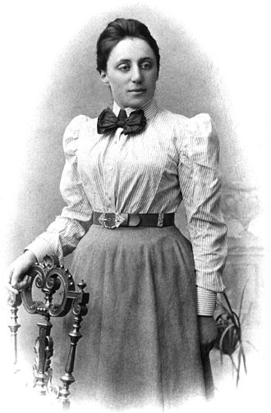
Emmy Noether
Notes:
# Name Emmy Noether # Textbook Knight, Physics for Scientists and Engineers: A Strategic Approach with Modern Physics, 3rd Edition, Chapter 10 # Contributor Mai Hoang # Description Amalie Emmy Noether was a German mathematician and physicist known for her landmark contributions to abstract algebra and theoretical physics. One of her most remarkable discoveries in physics was Noether's theorem. The theorem states that every differentiable symmetry of the action of a physical system has a corresponding conservation law. In 1915, Noether was helping two other scientists, David Hilbert and Felix Klein, to understand Albert Einstein's general relativity theory when she proved Noether's first theorem. Upon receiving her work, Einstein wrote to Hilbert: "Yesterday I received from Miss Noether a very interesting paper... I'm impressed that such things can be understood in such a general way. The old guard at Göttingen should take some lessons from Miss Noether! She seems to know her stuff." Noether's theorem has become a fundamental tool of modern theoretical physics because of the insight it gives into conservation laws and also being practical calculation tool. For example, suppose that a new physical phenomenon is discovered. Noether's theorem provides a test for theoretical models of the phenomenon: if the theory has a continuous symmetry, then Noether's theorem guarantees that the theory has a conserved quantity, and for the theory to be correct, this conservation must be observable in experiments. # Sources https://en.wikipedia.org/wiki/Emmy_Noether # Photo https://upload.wikimedia.org/wikipedia/commons/thumb/e/e5/Noether.jpg/330px-Noether.jpg

Slide 14
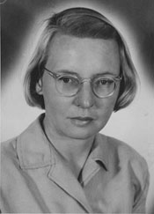
Ruby Payne-Scott
Notes:
# Name Ruby Payne-Scott # Textbook Knight, Physics for Scientists and Engineers: A Strategic Approach with Modern Physics, 3rd Edition, Chapter 15 # Contributors Megan Hedinger # Description Ruby Payne-Scott was an Australian born physicist and radio astronomer. She began work as a physicist with the cancer treatment center at the University of Sydney where she focused on radiation therapy as a form of cancer treatment. She later completed her master's thesis on wavelength distributions of radiation. Ruby worked briefly as a teacher before receiving a job in the radiophysics division of the Commonwealth Scientific and Industrial Research Organization where she worked on radar technology for the army. Her most notable contribution, however, lay in her interest in extraterrestrial radio signals. She demonstrated, with the help of two colleagues, that radio brightness across the sky could be treated as a two-dimensional sum of an infinite series of simple waveforms and showed that it could be computed using the Fourier transform. Ruby's work served as a mathematical foundation for radio astronomy. In addition to being a brilliant scientist, she was an avid supporter of women's rights believing in equal employment and pay for women. # Sources Goss, W., & Hooker, C. (2018). Biography - Ruby Violet Payne-Scott - Australian Dictionary of Biography. Adb.anu.edu.au. Retrieved 19 February 2018, from http://adb.anu.edu.au/biography/payne-scott-ruby-violet-15036 Ruby Payne-Scott [1912-1981] - CSIROpedia. (2018). CSIROpedia. Retrieved 19 February 2018, from https://csiropedia.csiro.au/payne-scott-ruby/ # Photo https://csiropedia.csiro.au/wp-content/uploads/2015/01/6235943.jpg

Slide 15
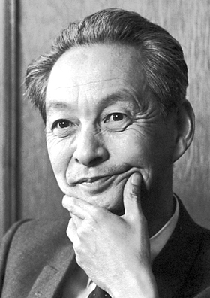
Shin'ichirō Tomonaga
Notes:
# Name Shin'ichirō Tomonaga # Textbook Knight, Physics for Scientists and Engineers: A Strategic Approach with Modern Physics, 3rd Edition, Chapter 30, section 3 # Contributors # Description Shin'ichirō Tomonaga was born on March 31, 1906 in Tokyo, Japan. He is a Japanese scientist who won the Nobel Prize in Physics in 1965 for developing basic principles of quantum electrodynamics. He was a professor of Physics at the Tokyo University of Education. From 1937 to 1939, he was in Germany to study nuclear physics and the quantum field theory. In 1940, he developed the intermediate coupling theory in order to clarify the structure of the meson cloud around the nucleon. During WWII, he solved the motion of electrons in the magnetron and also developed a unified theory of systems consisting of wave guides and cavity resonators. Dr. Tomonaga was the President of the Tokyo University of Education from 1956 to 1962. He has actively campaigned against the spread of nuclear weapons and for peaceful use of nuclear energy. # Sources https://www.britannica.com/biography/Tomonaga-Shinichiro https://www.nobelprize.org/nobel_prizes/physics/laureates/1965/tomonaga- bio.html https://en.wikipedia.org/wiki/Shin%27ichir%C5%8D_Tomonaga # Photo https://upload.wikimedia.org/wikipedia/commons/3/3a/Tomonaga.jpg

Slide 16
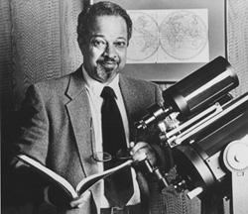
Arthur Walker Jr.
Notes:
# Name Arthur Walker Jr. # Textbook Knight, Physics for Scientists and Engineers: A Strategic Approach with Modern Physics, 3rd Edition, Chapter 19 # Description Arthur Bertram Cuthbert Walker Jr. (1936-2001) was a solar physicist and a pioneer of EUV/XUV. He was born in Cleveland, Ohio. Dr. Walker Jr. completed his undergraduate studies at Case Institute of technology in Cleveland in 1957 and earned his bachelor’s degree in physics. He completed both his master’s and doctorate degrees in astrophysics in the University of Illinois, in 1958 and 1962 respectively. He is most noted for having developed the solar corona. Two of his sounding rocket payloads, the Stanford/MSFC Rocket Spectroheliograph Experiment and the Multi-Spectral Solar Telescope Array, recorded the first full-disk, high-resolution images of the Sun in XUV with conventional geometries of normal incidence optics; this technology is now used in solar telescopes such as SOHO/EIT and TRACE, and in the fabrication of microchips via ultraviolet photolithography. Dr. Walker's scientific research focused on radiation from the Sun called extreme ultraviolet light and soft X-rays, which affect the chemistry of Earth's upper atmosphere, including the ozone layer. In the late 1970's, Dr. Walker became interested in what was then considered a risky and untested concept, called multilayer technology, for making special telescope mirrors that could reflect that radiation. He was a professor at Stanford University from 1974 until his death in 2001 and was a member of the Stanford’s Center for Space and Astrophysics at the school. In addition to his impressive contributions to the field, Dr. Walker Jr. spent a lifetime helping women and minority students find careers in science. He is credited with helping Stanford produce more black physicists with Ph.D.’s than any other university in the nation. # Sources Arthur Bertram Cuthbert Walker, Jr. (n.d.). Retrieved February 18, 2018, from http://www.math.buffalo.edu/mad/physics/walker_arthurbc.html Arthur Bertram Cuthbert Walker, Jr. (n.d.). Retrieved February 18, 2018, from http://www.math.buffalo.edu/mad/physics/walker_arthurbc.html # Photo http://www.math.buffalo.edu/mad/PIX/Walker.abc_old.jpg

Slide 17
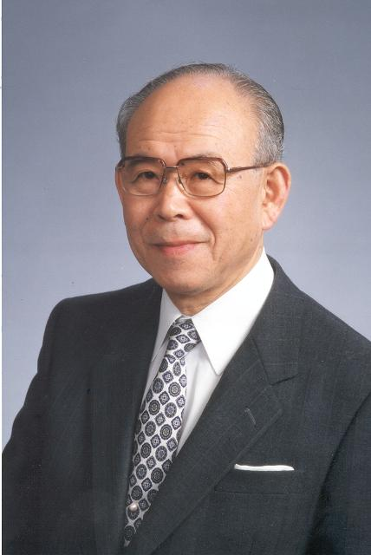
Isamu Akasaki
Notes:
# Name Isamu Akasaki # Textbook Knight, Physics for Scientists and Engineers: A Strategic Approach with Modern Physics, 3rd Edition, Chapter 30 #Contributors # Description The main contribution of Isamu Akasaki is in the semiconductor field. He, along with Hiroshi Amano and Shuji Nakamura invented efficient blue light-emitting diodes, and won the 2014 Noble Prize in Physics. He worked on GaN to make high-brightness blue LED light. As a result, people are able to have bright white LED light as an energy-saving light source. # Sources "Isamu Akasaki." Isamu Akasaki - Engineering and Technology History Wiki, http://ethw.org/Isamu_Akasaki. "Isamu Akasaki." Wikipedia, Wikimedia Foundation, 4 Oct. 2017, http://en.wikipedia.org/wiki/Isamu_Akasaki. # Photo http://ethw.org/w/images/7/7c/Isamu_Akasaki_2482.jpg

